Slide 1
N=100000

Slide 3
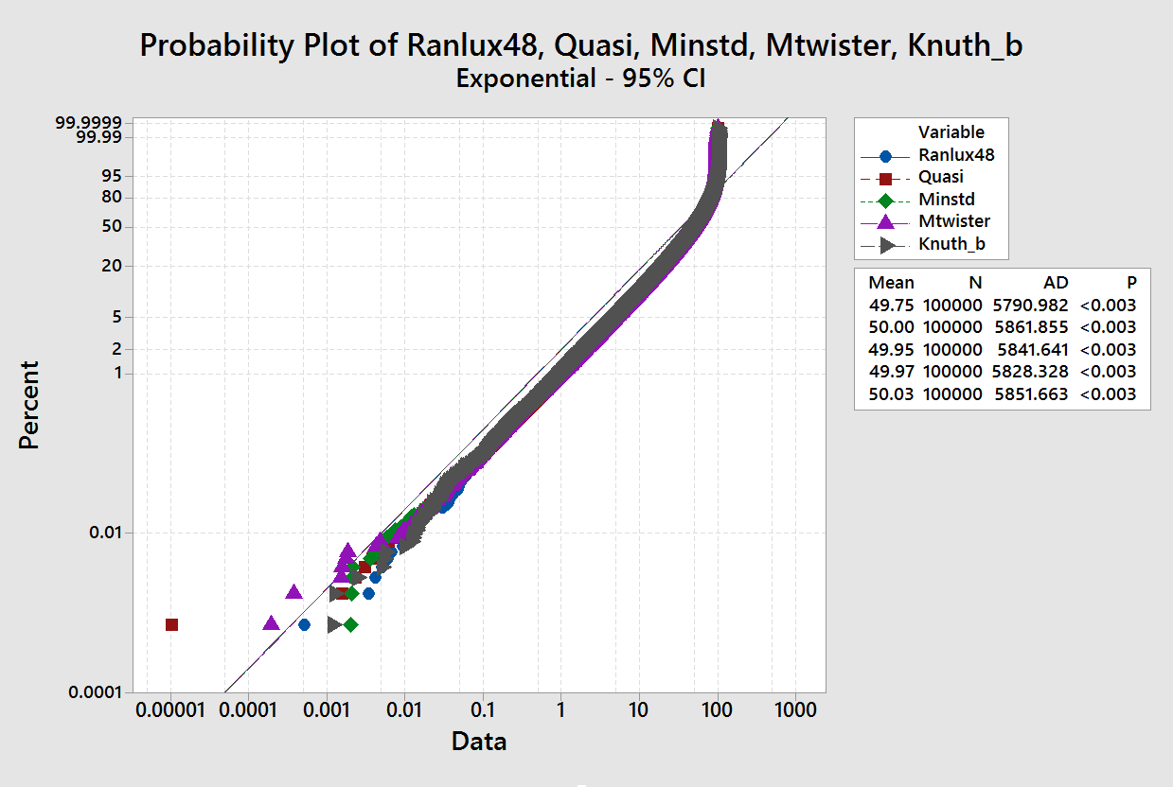

Slide 4
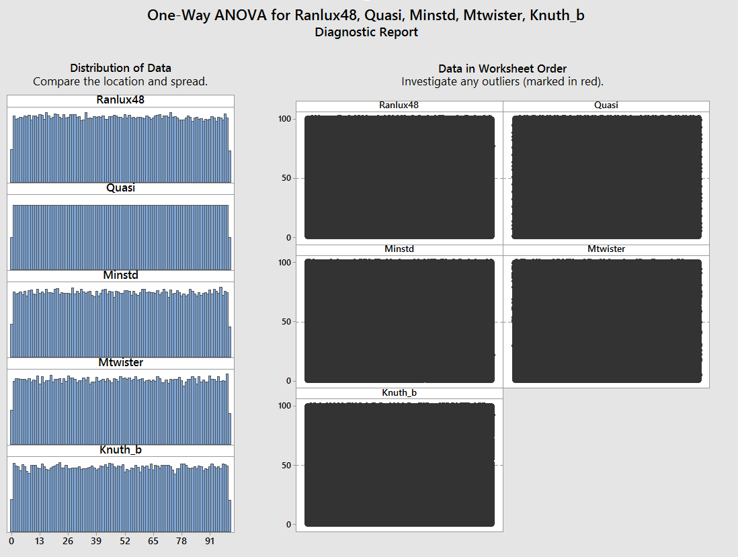

Slide 11
Spearman Rho: Ranlux48, Quasi, Minstd, Mtwister, Knuth_b
Ranlux48 Quasi Minstd Mtwister
Quasi -0.003
0.282
Minstd -0.002 0.001
0.588 0.806
Mtwister -0.001 0.004 0.001
0.676 0.216 0.747
Knuth_b -0.005 0.001 -0.001 -0.000
0.136 0.691 0.716 0.991
Cell Contents: Spearman rho

Slide 12
Distributions

Slide 22
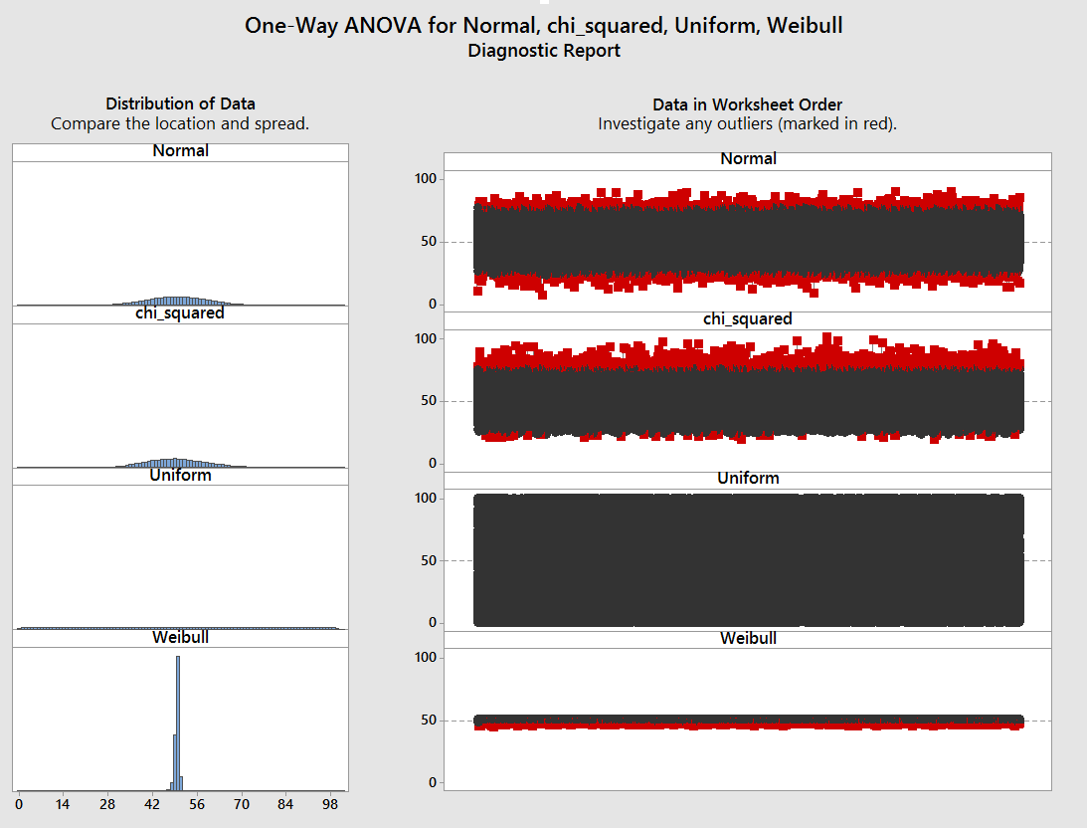

Slide 24
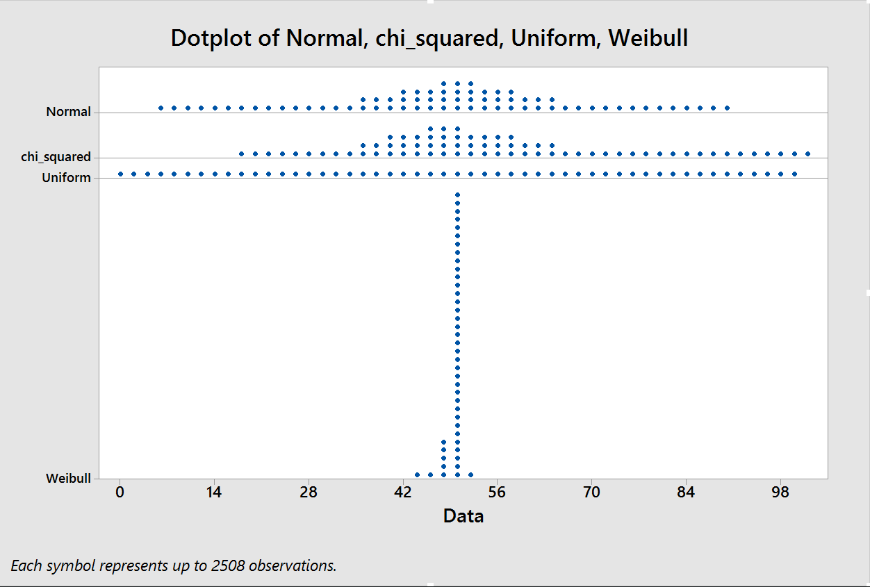

Slide 25
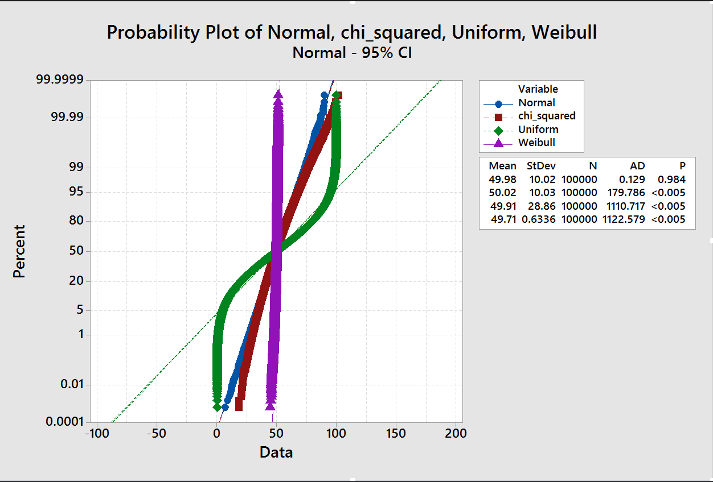

Slide 26
N=10000

Slide 33
N=50000

Slide 38
